Slide 1
Introduction
Describe the general layout of NFPA 101

Slide 2
Historic Fire
Triangle Shirtwaist Factory

Slide 3
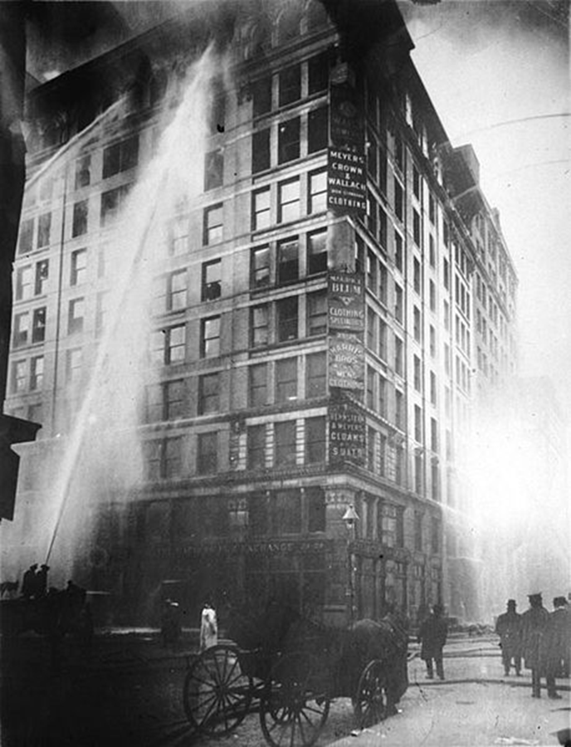
Fire Resistance Construction
Buildings were called “fireproof” based on limited combustibles
Now known by fire resistance

Slide 4
The NFPA Manual of Style
A vertical line in the margin indicates a change in the standard before 2015
  Shaded text in 2018- N, Δ, text
An asterisk * in front of a section indicates additional info in Annex A
A bullet indicates something was deleted (not 2015)
First numeral of a section number indicates the chapter

Slide 5

Chapter 1
Administration
Minimize danger to life from fire
  Construction protection and occupancy features
  Egress facilities from building or to safe area
  Protective systems, building services, operating and maintenance features
Not a building code or fire prevention code
Will not provide protection from acts of negligence
Preserving property not an objective
Intended for fire
  Might be beneficial in similar situations

Slide 6

NFPA101 and IBC
Both have Life Safety requirements
IBC also has structural requirements
Many differences
  Terminology
  Gray areas
  Some requirements
Adoption
  Federal
  State

Slide 7
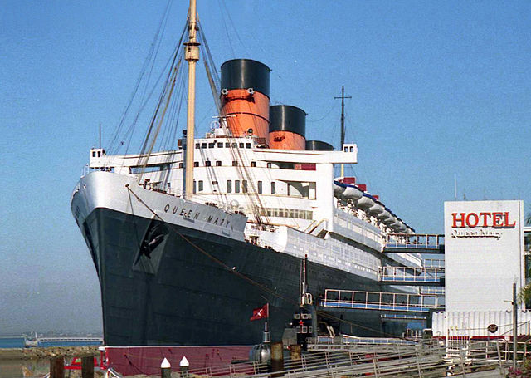
Chapter 1
Application
  New and existing buildings
  Vehicles and vessels immobile and used for human occupancy
Equivalency
  Not intended to prevent systems equal or superior alternatives
  Technical documentation required
  AHJ approves alternate approaches in compliance with code

Slide 8
Chapter 2
Mandatory References
Documents referenced by LSC as mandatory requirements and considered part of the code
Impractical to continually upgrade existing buildings
Existing buildings that do not comply shall be permitted to continue service
  If nonconformity does not present a serious hazard to occupants

Slide 9
Chapter 3
Contains important definitions used in the industry and throughout this course
  Learn the NFPA definitions (you need them for all codes)
  Others learn as they are used
    Never assume standard dictionary definition

Slide 10
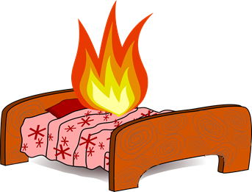
Chapter 4
General
Goals
Reasonable safety from fire and similar emergencies
Protection of occupants not intimate with initial fire
Improve survivability of occupants intimate with fire
Reasonably safe emergency/nonemergency crowd movement

Slide 11
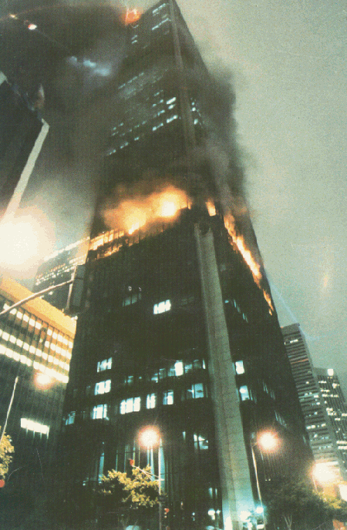
Chapter 4
Objectives
  Protect occupants not intimate with fire for time necessary to evacuate, relocate, or defend in place
  Structural integrity maintained for time necessary to evacuate, relocate, or defend in place
  Systems shall be designed and maintained to meet goals
Assumptions
  Single fire

Slide 12
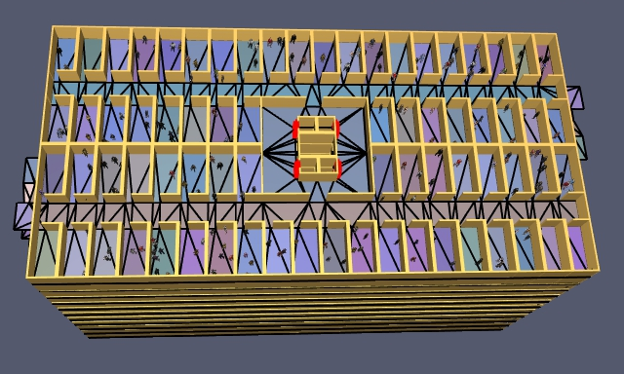
Chapter 4
Compliance options
Prescriptive Based Option
  General chapters (1-4, 6-11, 43)
  Occupancy chapters
  AHJ has final determination
Performance-based option
  Chapter 5

Slide 13
Chapter 4
Must have multiple safeguards
  Cannot rely on single safeguard
Appropriateness of safeguards
  Character of occupancy
  Capabilities of occupants
  Number of occupants
  Fire protection provided
  Capabilities of response personnel
  Height and type of construction
  Other factors providing safety

Slide 14
General Requirements
Chapter 6: Classification of Occupancy and Hazard of contents
Chapter 7: Means of Egress
Chapter 8: Features of Fire Protection
Chapter 9: Building Services and Fire Protection Equipment
Chapter 10: Interior Finish, Contents, and Furnishings
Chapter 11: Special Structures and High-Rise Buildings

Slide 15
NFPA 170
Chapter 4
Chapter 6

